Slide 1
Week05 Deep Learning
Report Date：2023/05/28
Reporter：楊智皓

Slide 2
Outline
Three Steps for Deep Learning
Backpropagation
Tips for Training DNN
Why Deep?
General Guide

Slide 3
Three Steps for Deep Learning

Slide 4
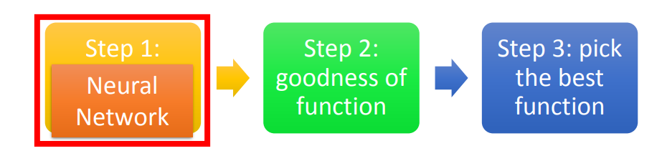
Three Steps for Deep Learning

Slide 5
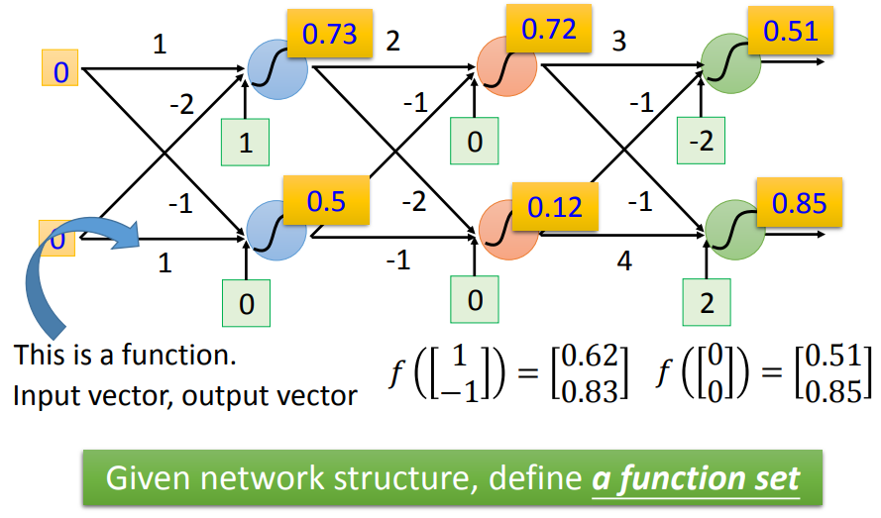
Fully Connect Feedforward Network

Slide 6
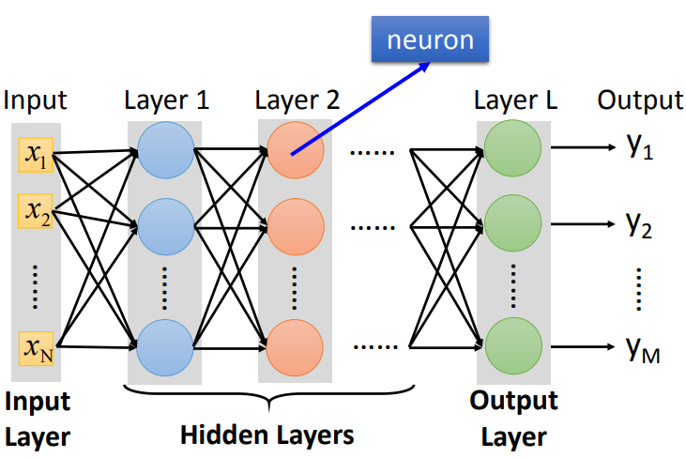
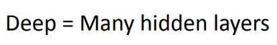
Fully Connect Feedforward Network

Slide 7
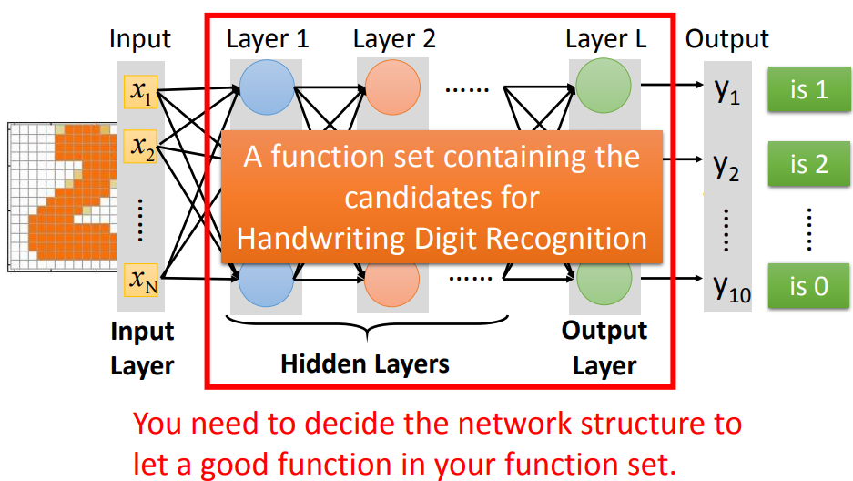
Example Application

Slide 8
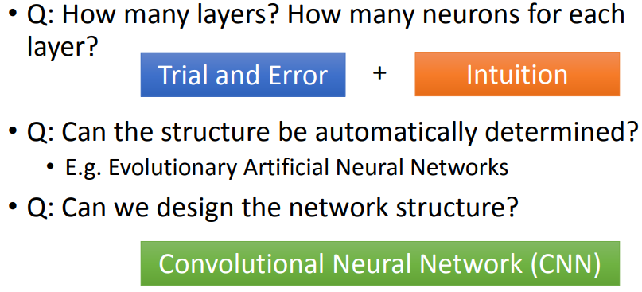
FAQ

Slide 9
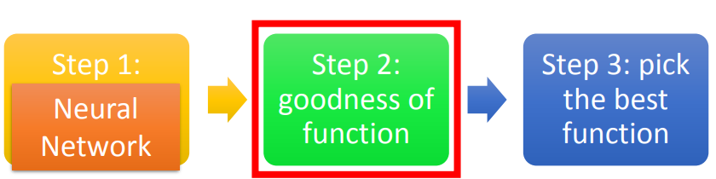
Three Steps for Deep Learning

Slide 10
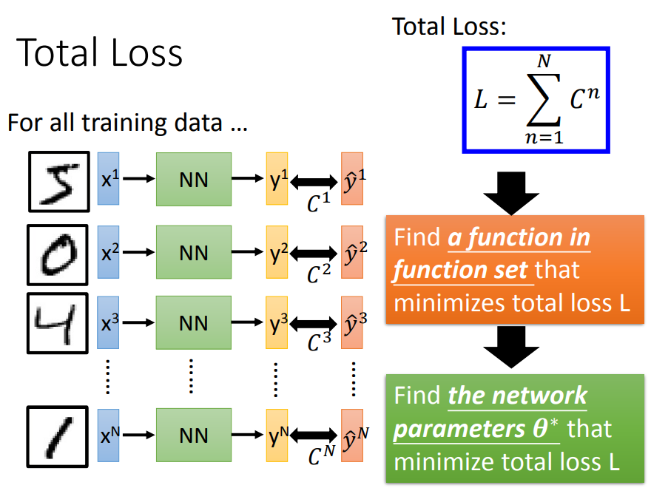

Slide 11
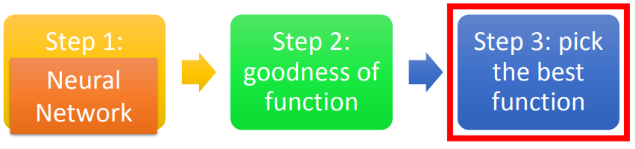
Three Steps for Deep Learning

Slide 12
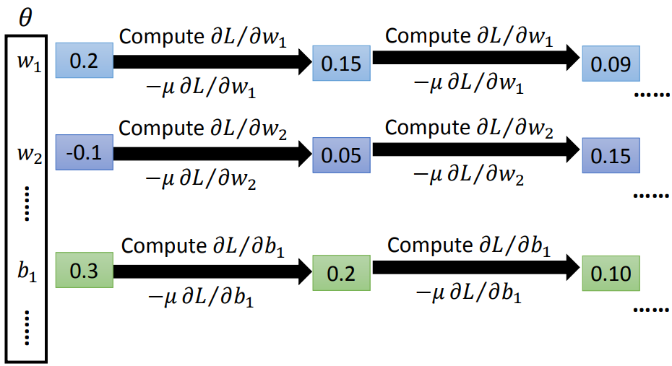
Gradient Descent

Slide 13
Backpropagation

Slide 14
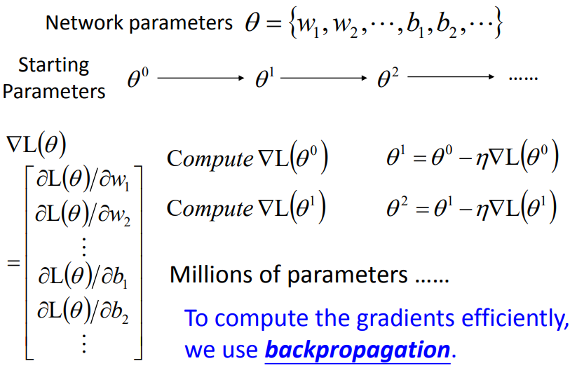
Backpropagation

Slide 15
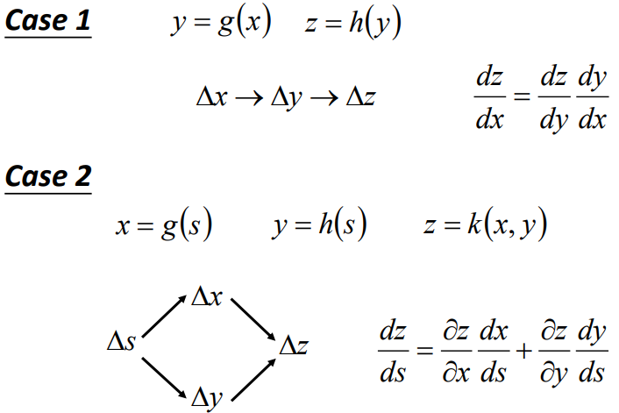
Chain Rule

Slide 16
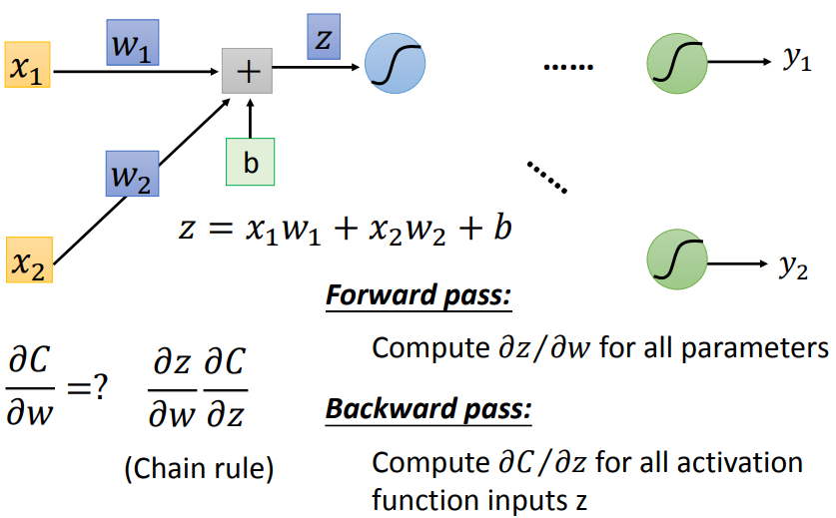
Backpropagation
Loss of one input

Slide 17
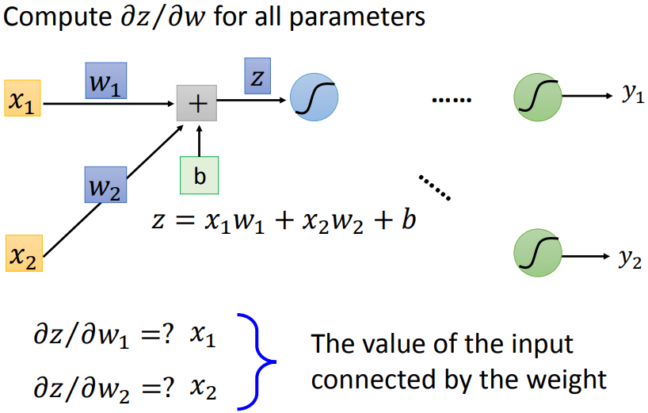
Backpropagation – Forward Pass

Slide 18
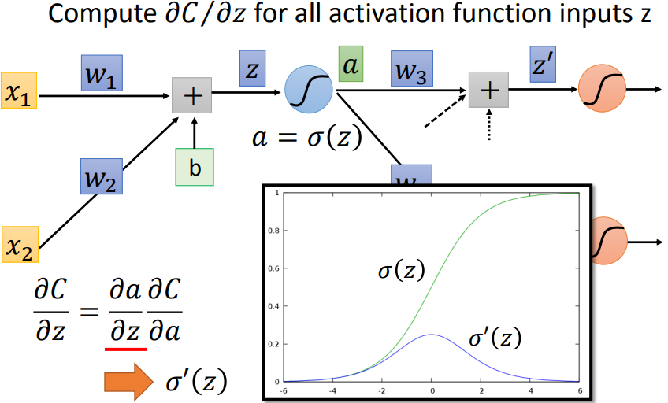
Backpropagation – Backward Pass

Slide 19
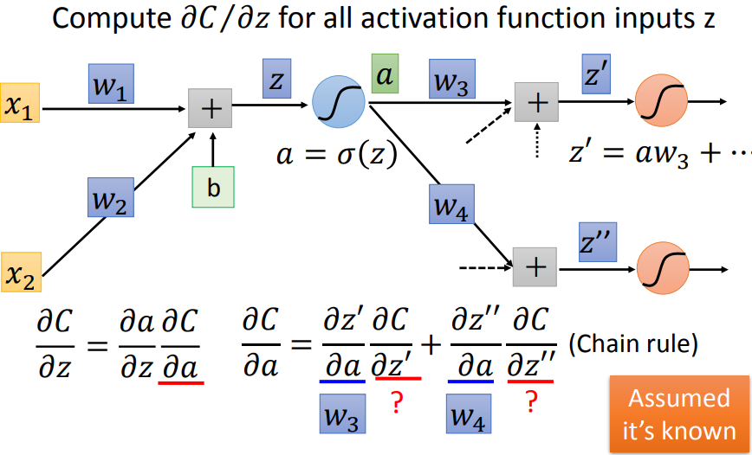
Backpropagation – Backward Pass

Slide 20
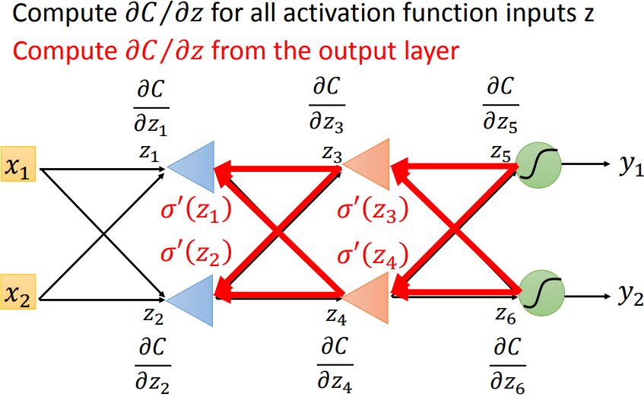
Backpropagation – Backward Pass

Slide 21
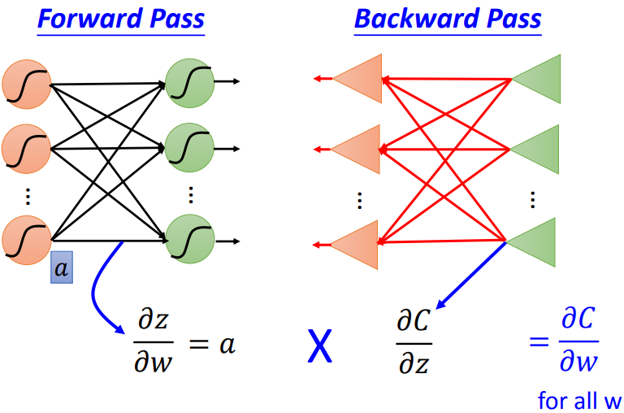
Backpropagation – Summary

Slide 22
Tips for Training DNN

Slide 23
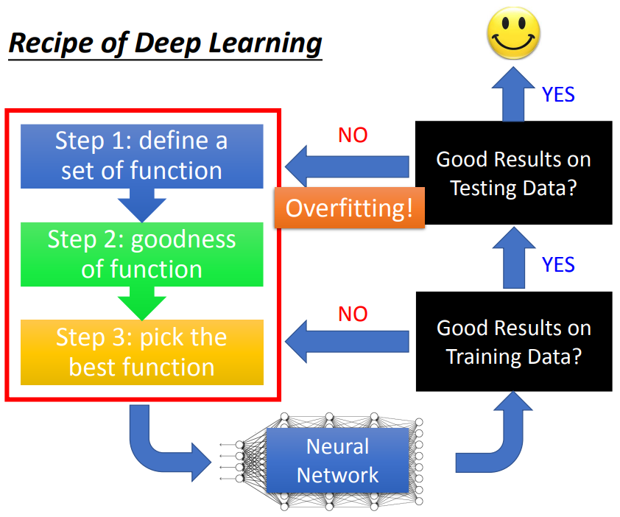

Slide 24
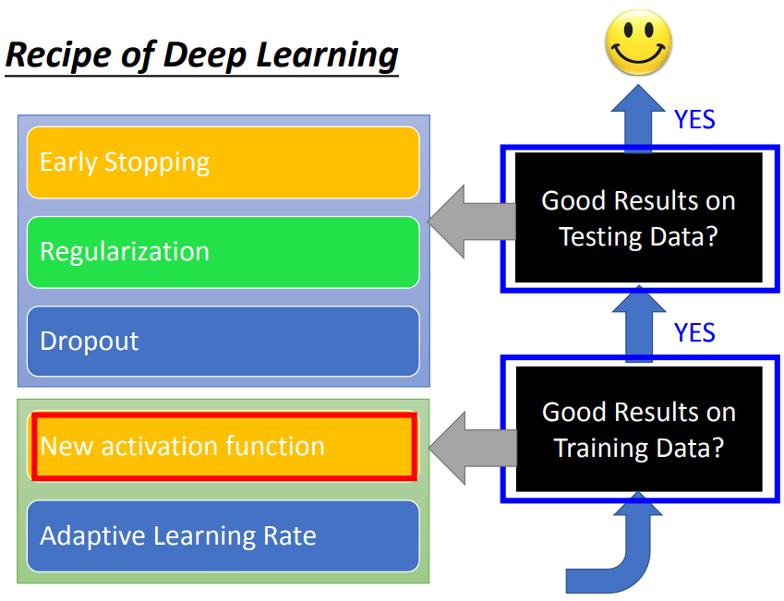

Slide 25
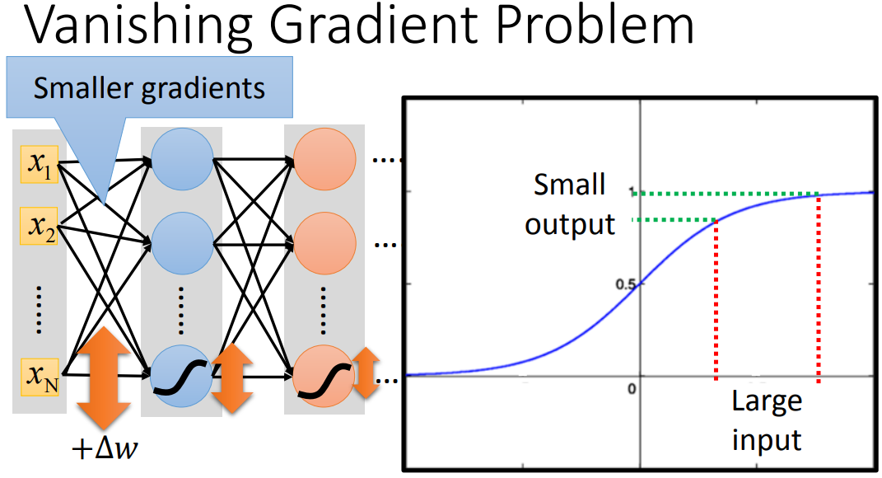

Slide 26
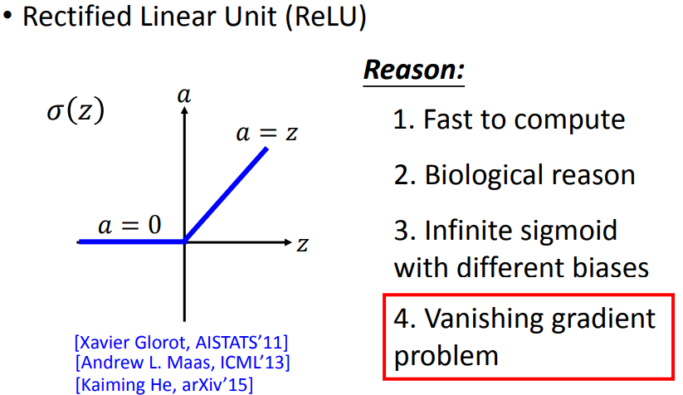
ReLU

Slide 27
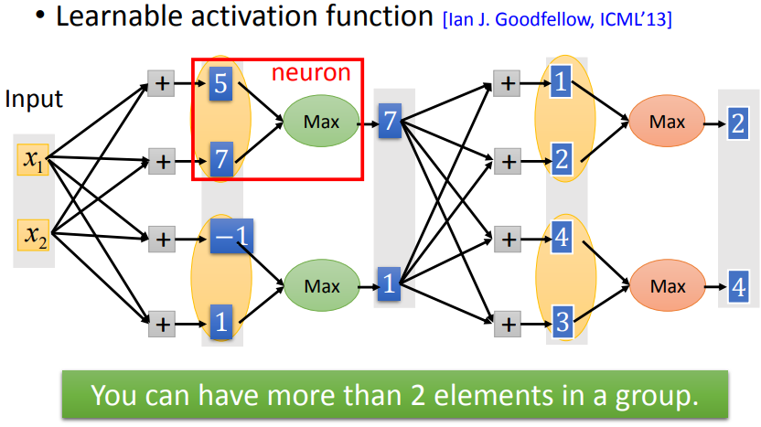
MaxOut

Slide 28
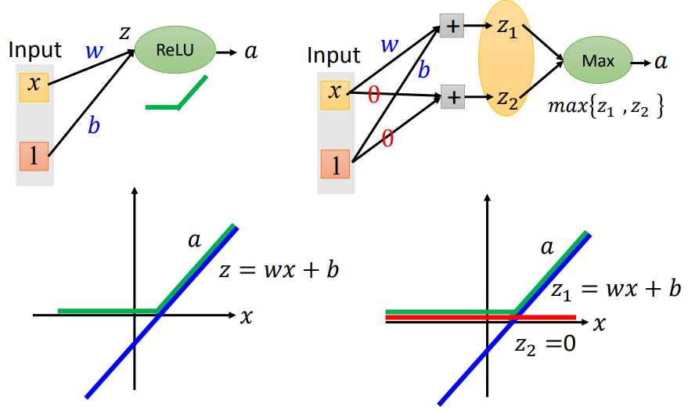
MaxOut

Slide 29
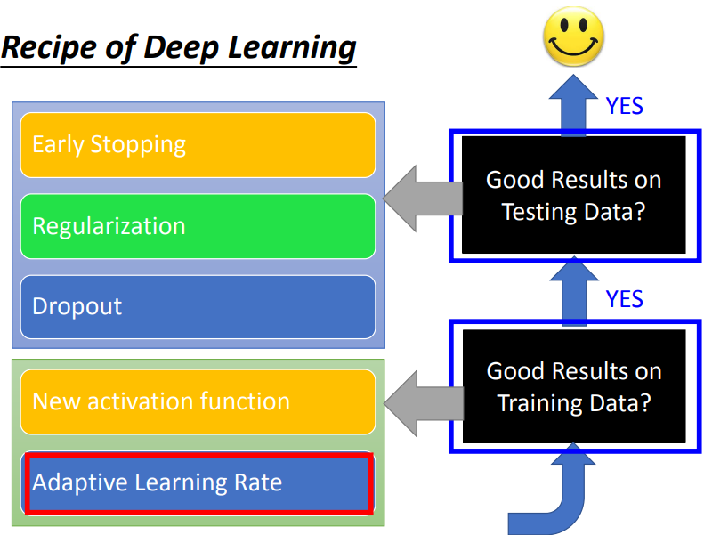

Slide 30
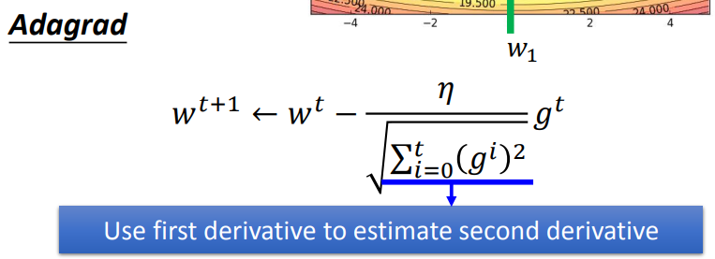
Adagrad

Slide 31
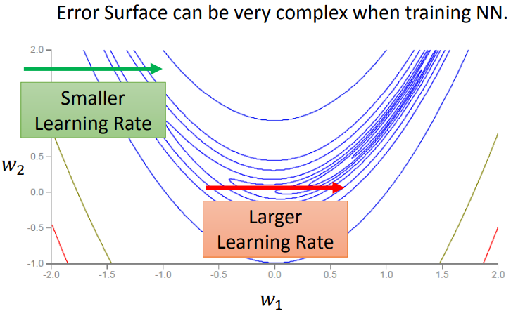
RMSProp

Slide 32
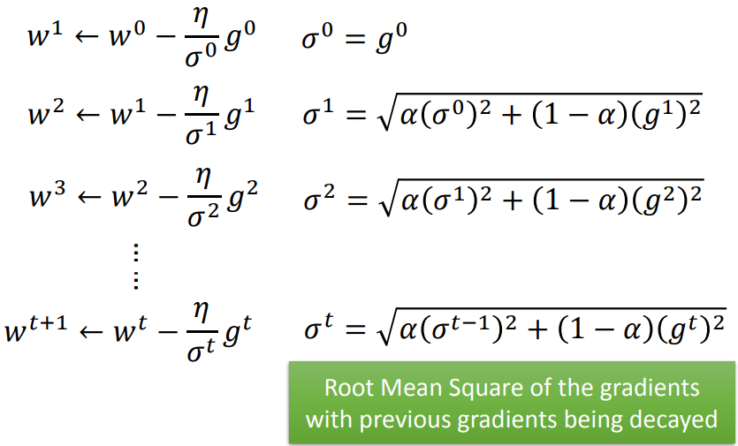
RMSProp

Slide 33
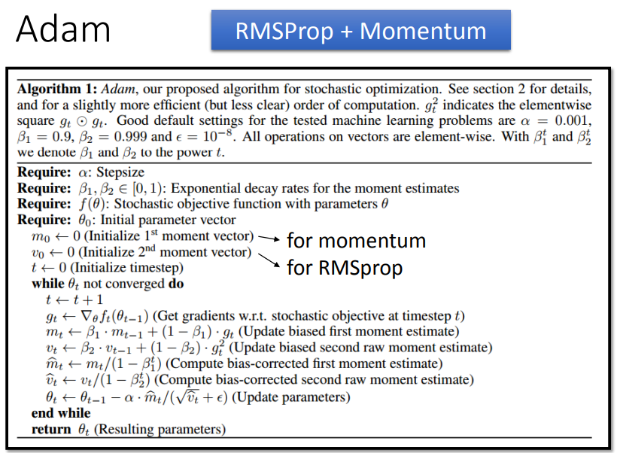

Slide 34
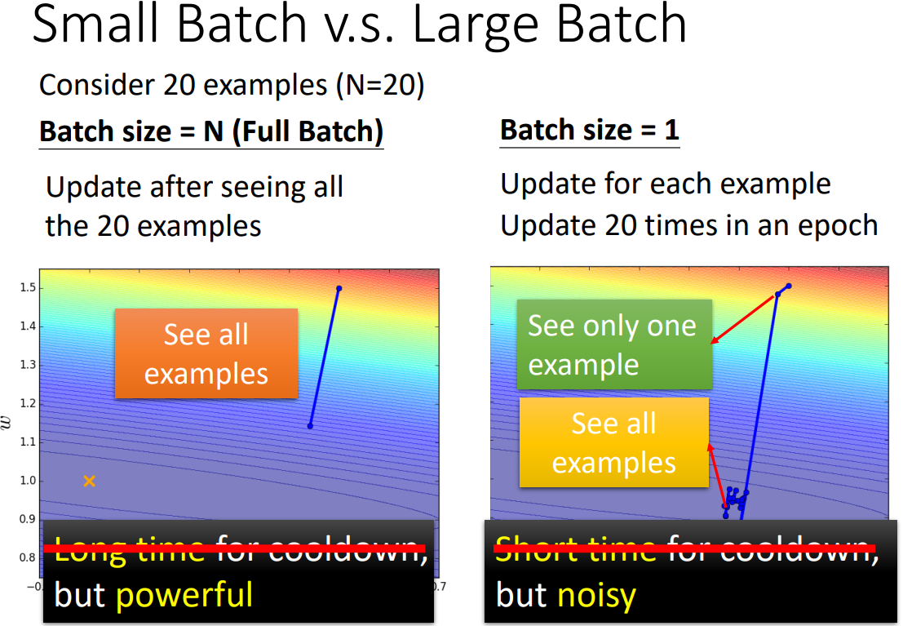

Slide 35
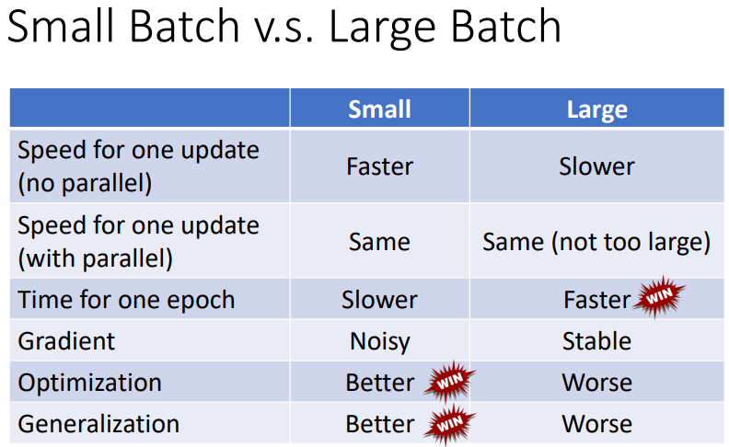

Slide 36
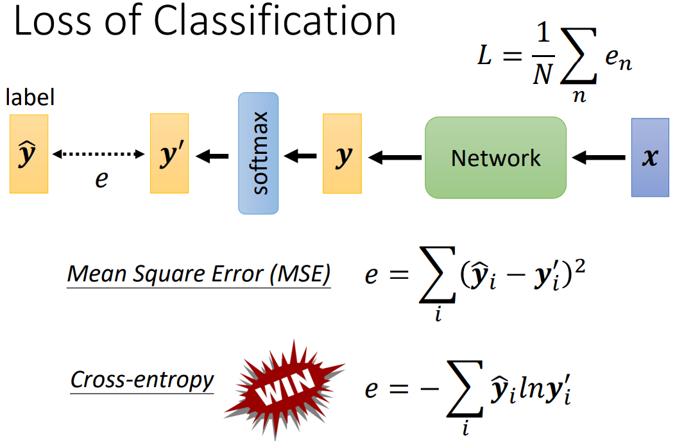

Slide 37
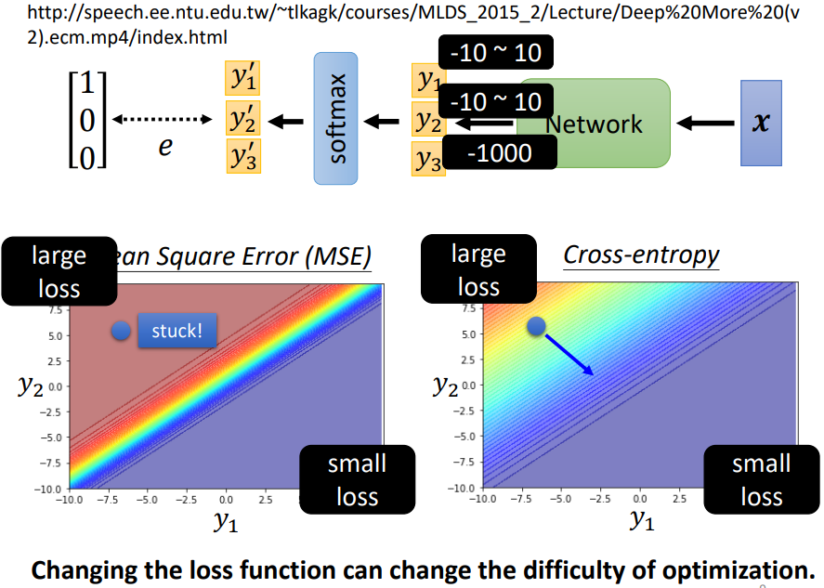

Slide 38
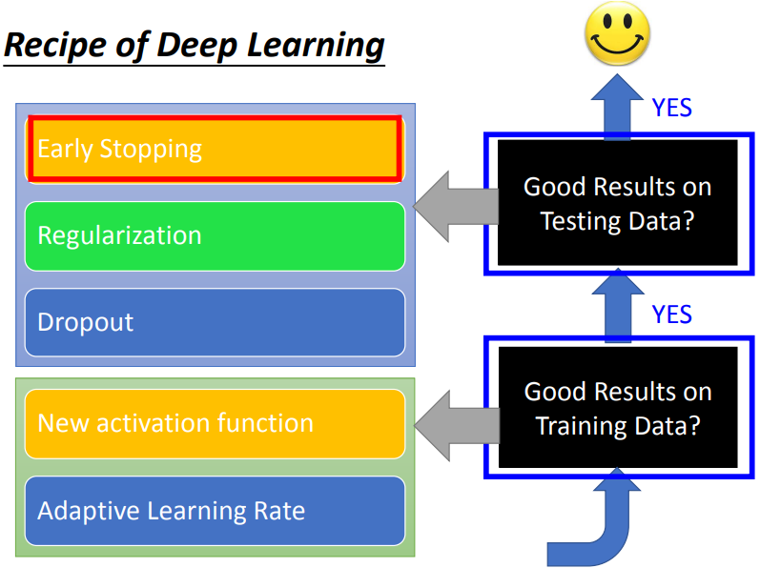

Slide 39
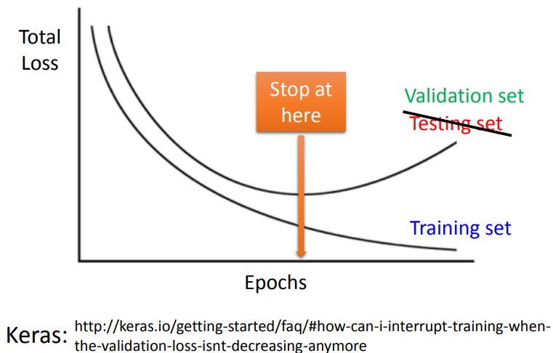
Early Stopping

Slide 40
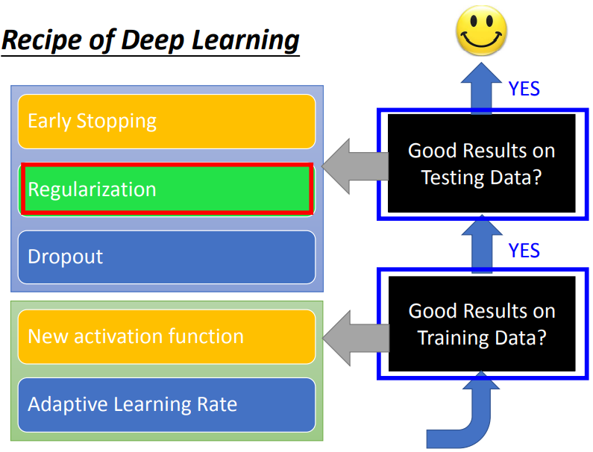

Slide 41
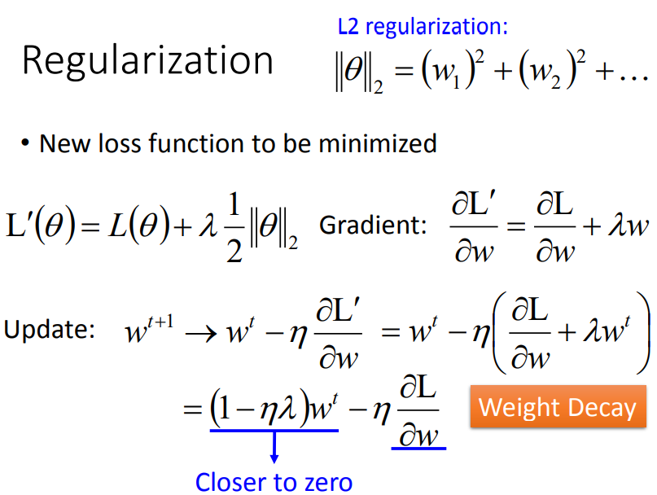

Slide 42
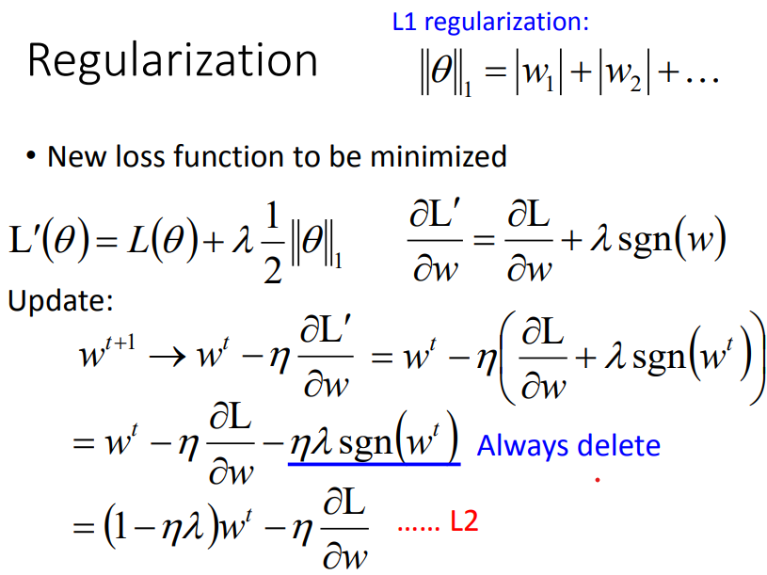

Slide 43
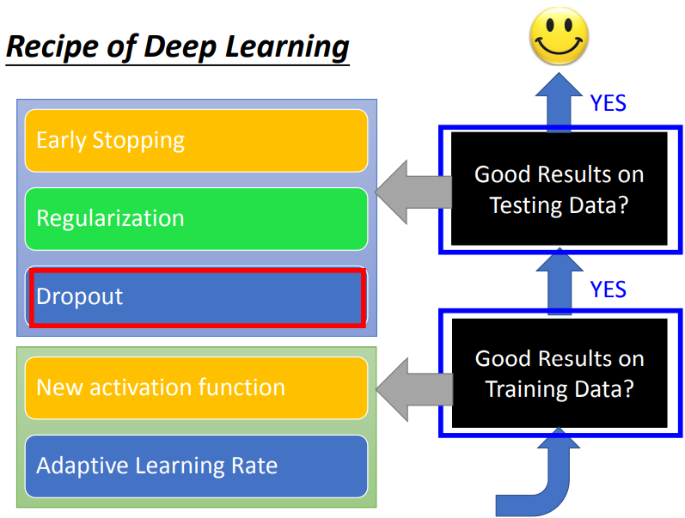

Slide 44
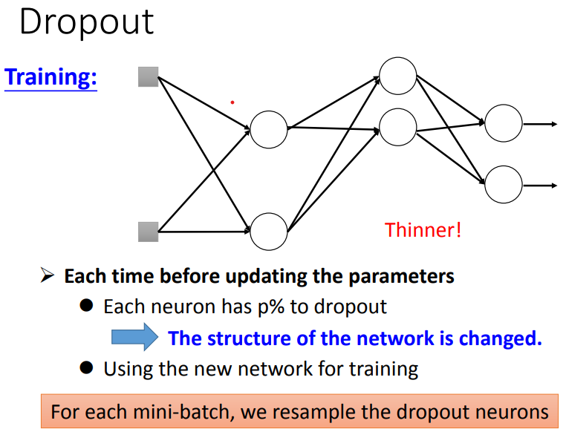

Slide 45
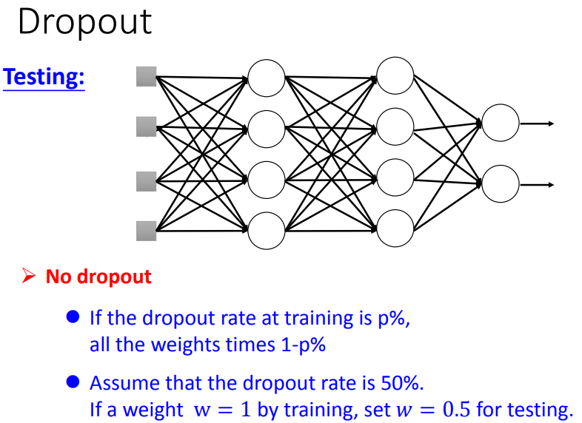

Slide 46
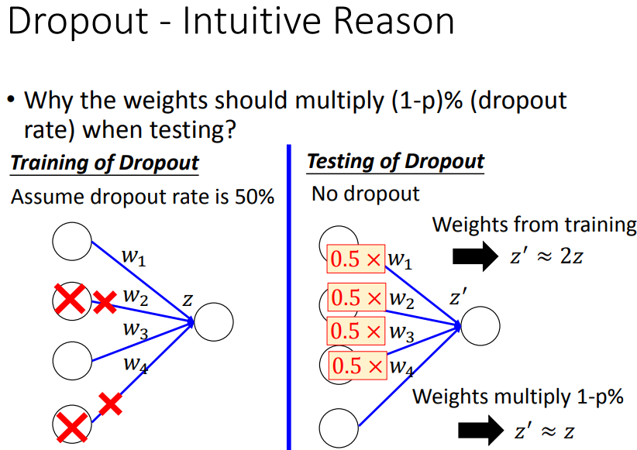

Slide 47
Why Deep?

Slide 48
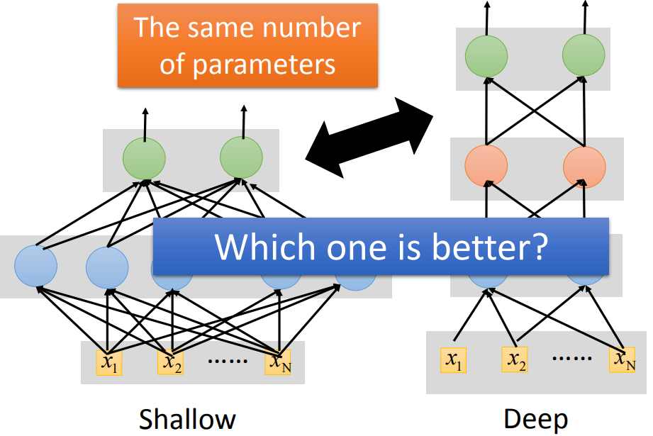
Fat + Short v.s. Thin + Tall

Slide 49
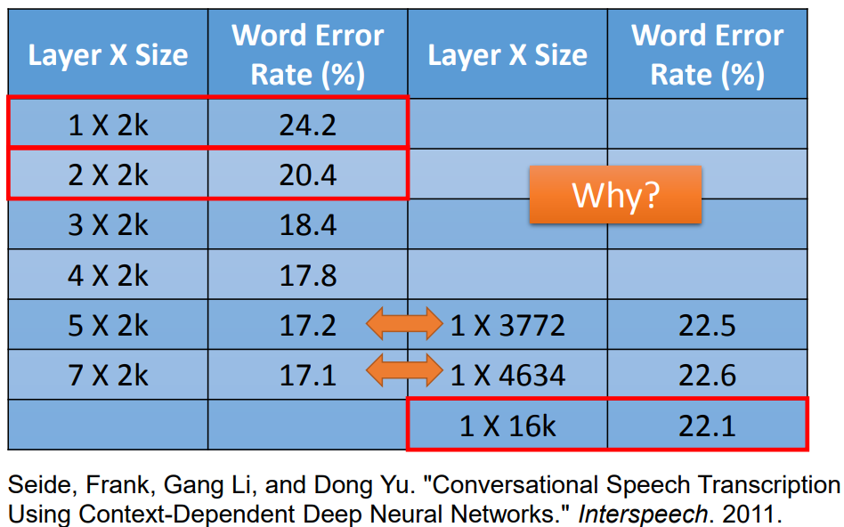
Fat + Short v.s. Thin + Tall

Slide 50
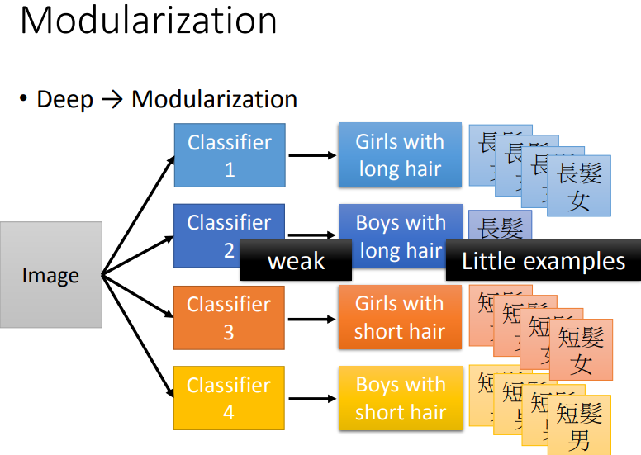

Slide 51
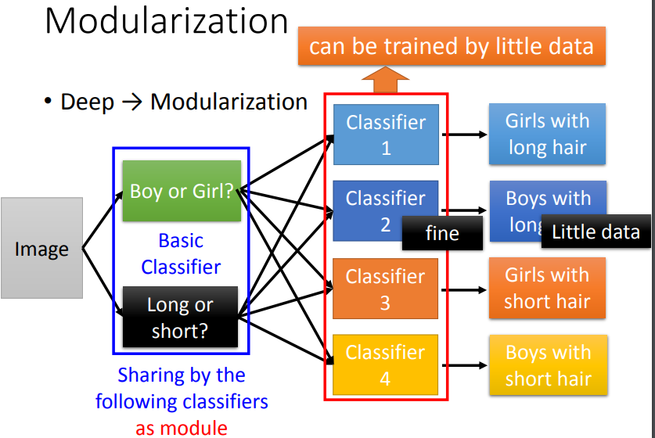

Slide 52
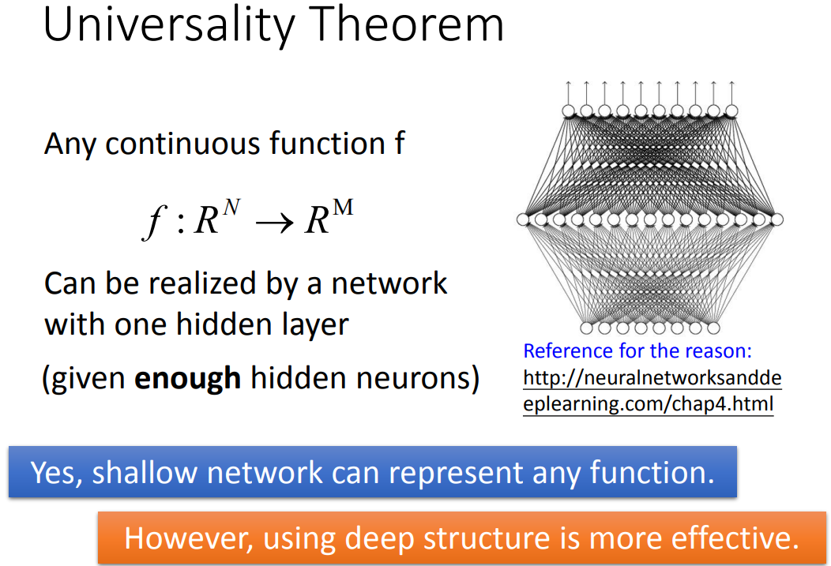

Slide 53
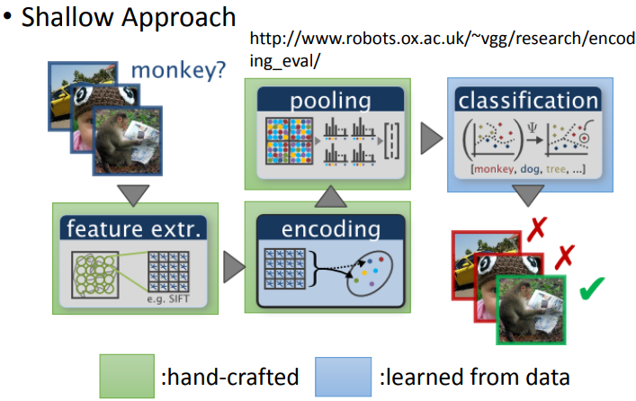
End-to-end Learning - Image Recognition

Slide 54
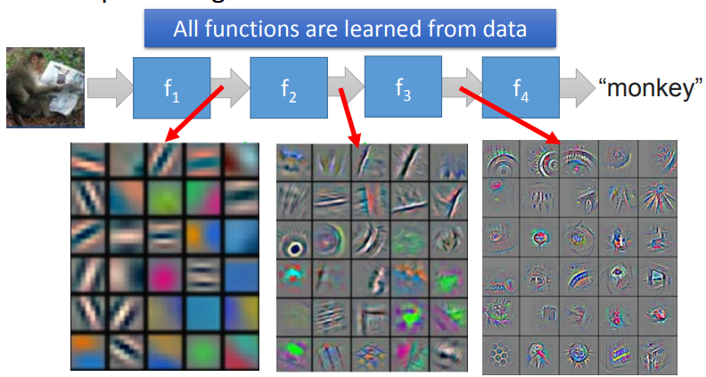
End-to-end Learning - Image Recognition

Slide 55
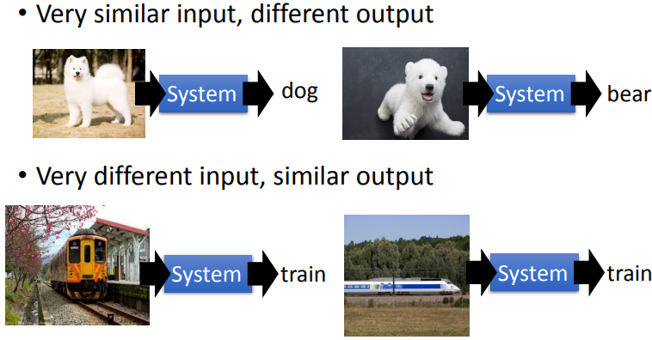
Complex Task

Slide 56


Slide 57
General Guide

Slide 58


Slide 59


Slide 60


Slide 61

Optimization Issue

Slide 62


Slide 63


Slide 64


Slide 65

Mismatch

